Slide 1
MY JOURNAL TO PYTHON
NAME: 珍古絲汀
TEACHER:

Slide 2
AGENDA
Python
Input and output: input() and print()
Data types: numerisc, strings, list , dict
Operators ON data type:
CONTROLS : IF- | IF –ELSIF |-F-ELSE
LOOP: FOR |WHILE | RANGE() | BREAK | CONTINUE
FUNCTION:
PARAMETERS(ARGUMETNS)
RECURSIVE FUNCTION
LAMBDA FUNCTION

Slide 3
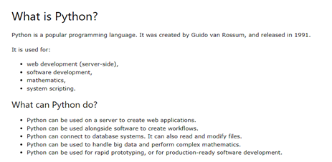
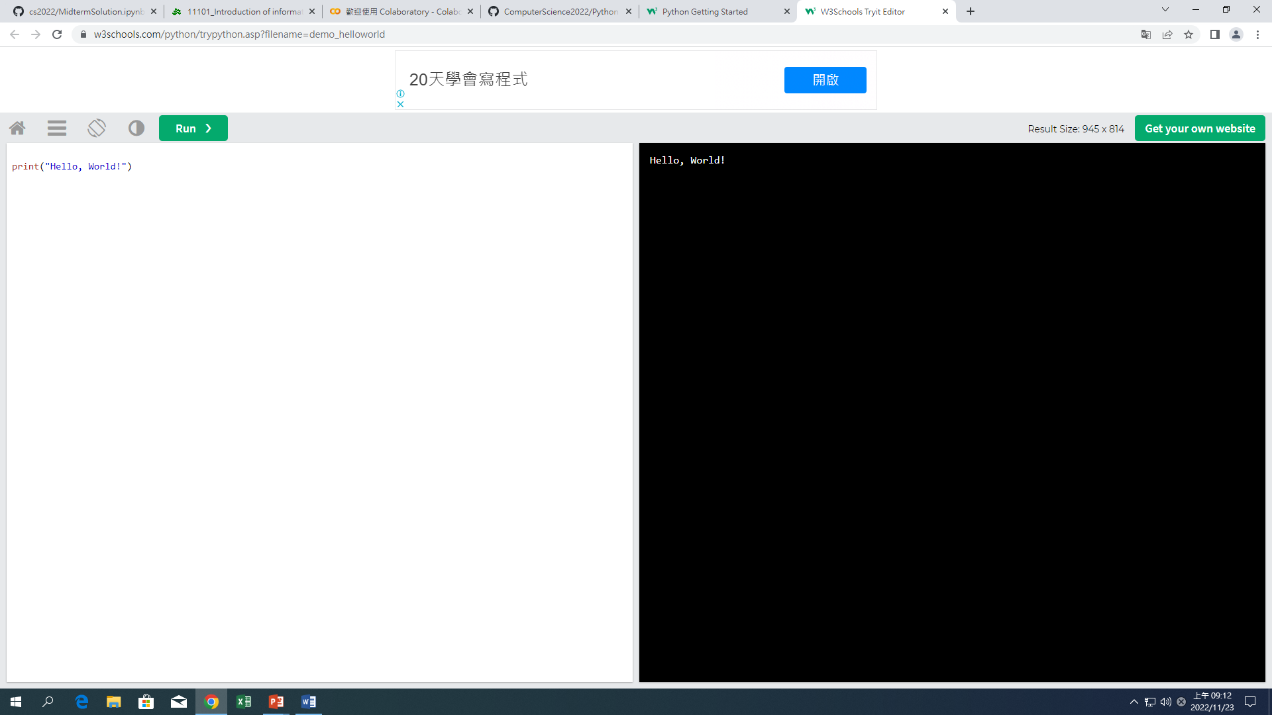
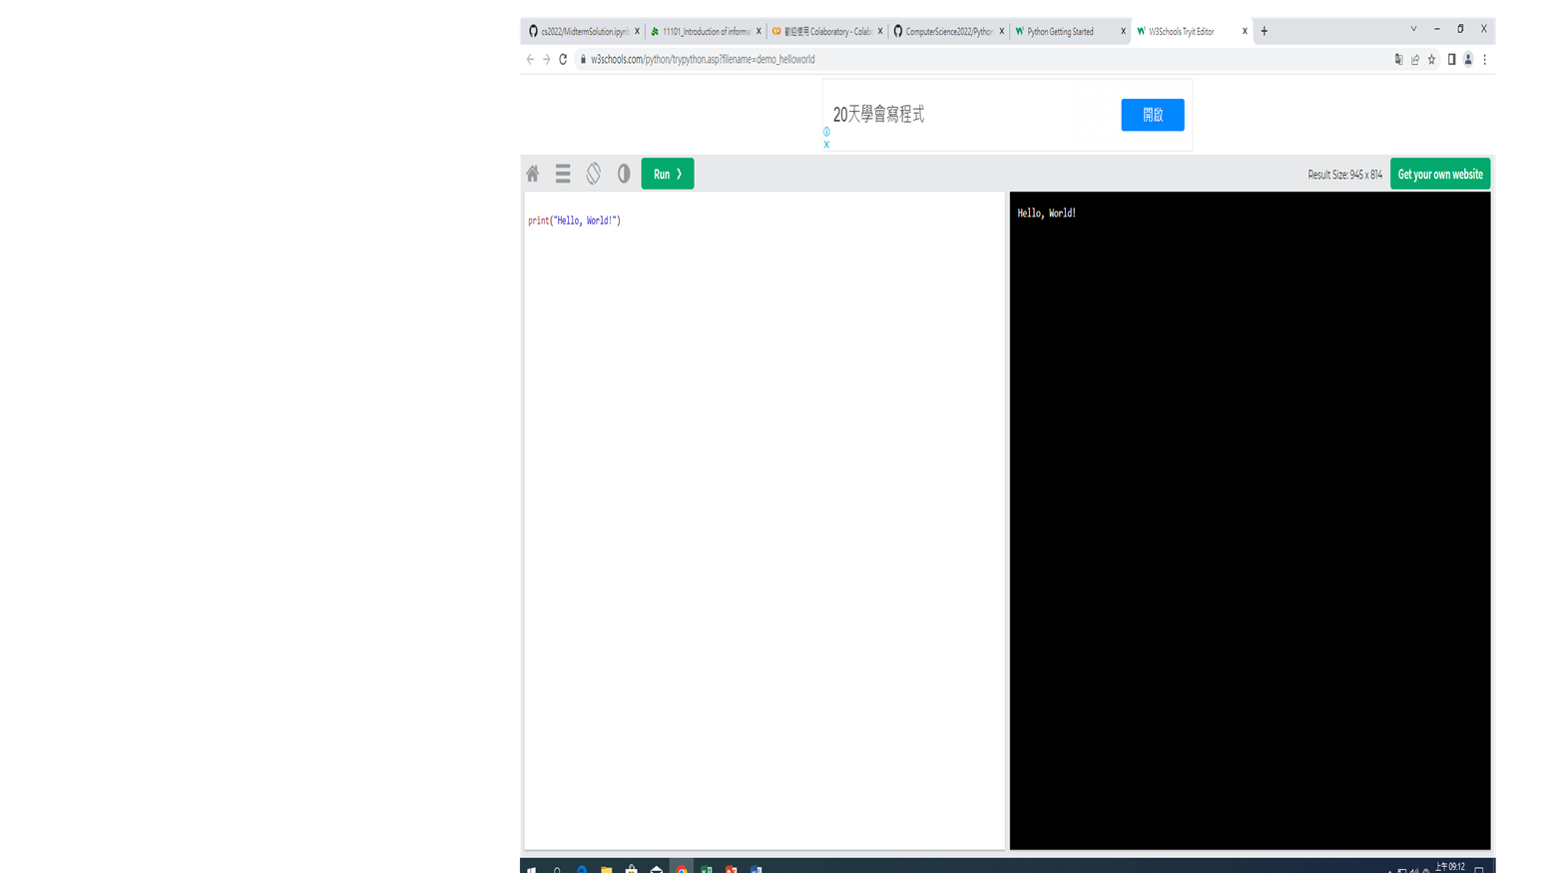
PYTHON
1 | What can Python do? (A)Python can be used on a server to create web applications. (B)Python can be used alongside software to create workflows. (C)Python can connect to database systems. It can also read and modify files. (D)Python can be used to handle big data and perform complex mathematics.
 | https://www.w3schools.com/python/python_intro.asp
EXAMPLE:

Slide 4
PYTHON SYNTAX
Python syntax can be executed by writing directly in the Command Line:
Or by creating a python file on the server, using the .py file extension, and running it in the Command Line:
>>> print("Hello, World!") Hello, World!
C:\Users\Your Name>python myfile.py

Slide 5

PYTHON IDENTATION
Indentation refers to the spaces at the beginning of a code line. Where in other programming languages the indentation in code is for readability only, the indentation in Python is very important. Python uses indentation to indicate a block of code.
EXAMPLE:

Slide 6
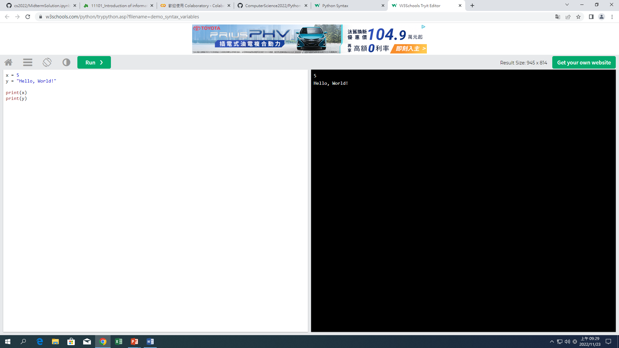
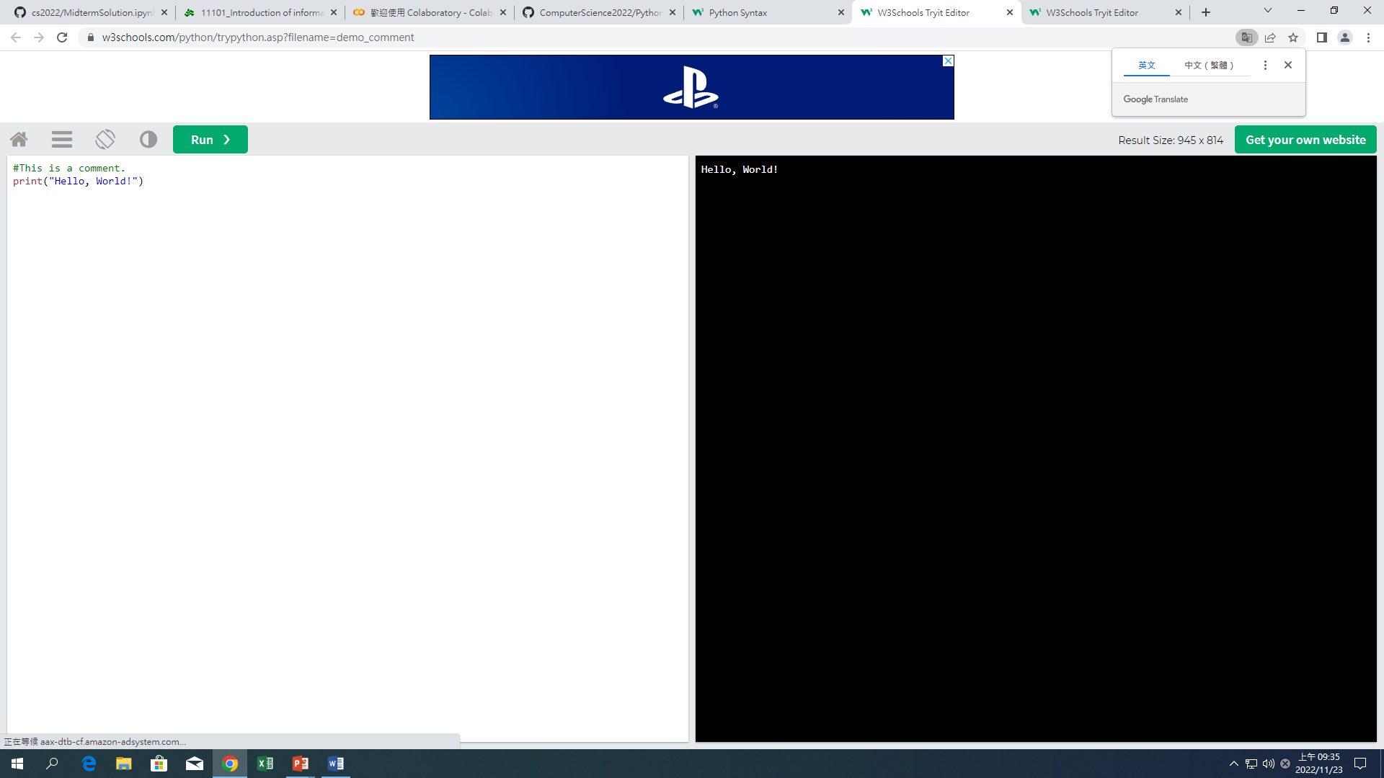
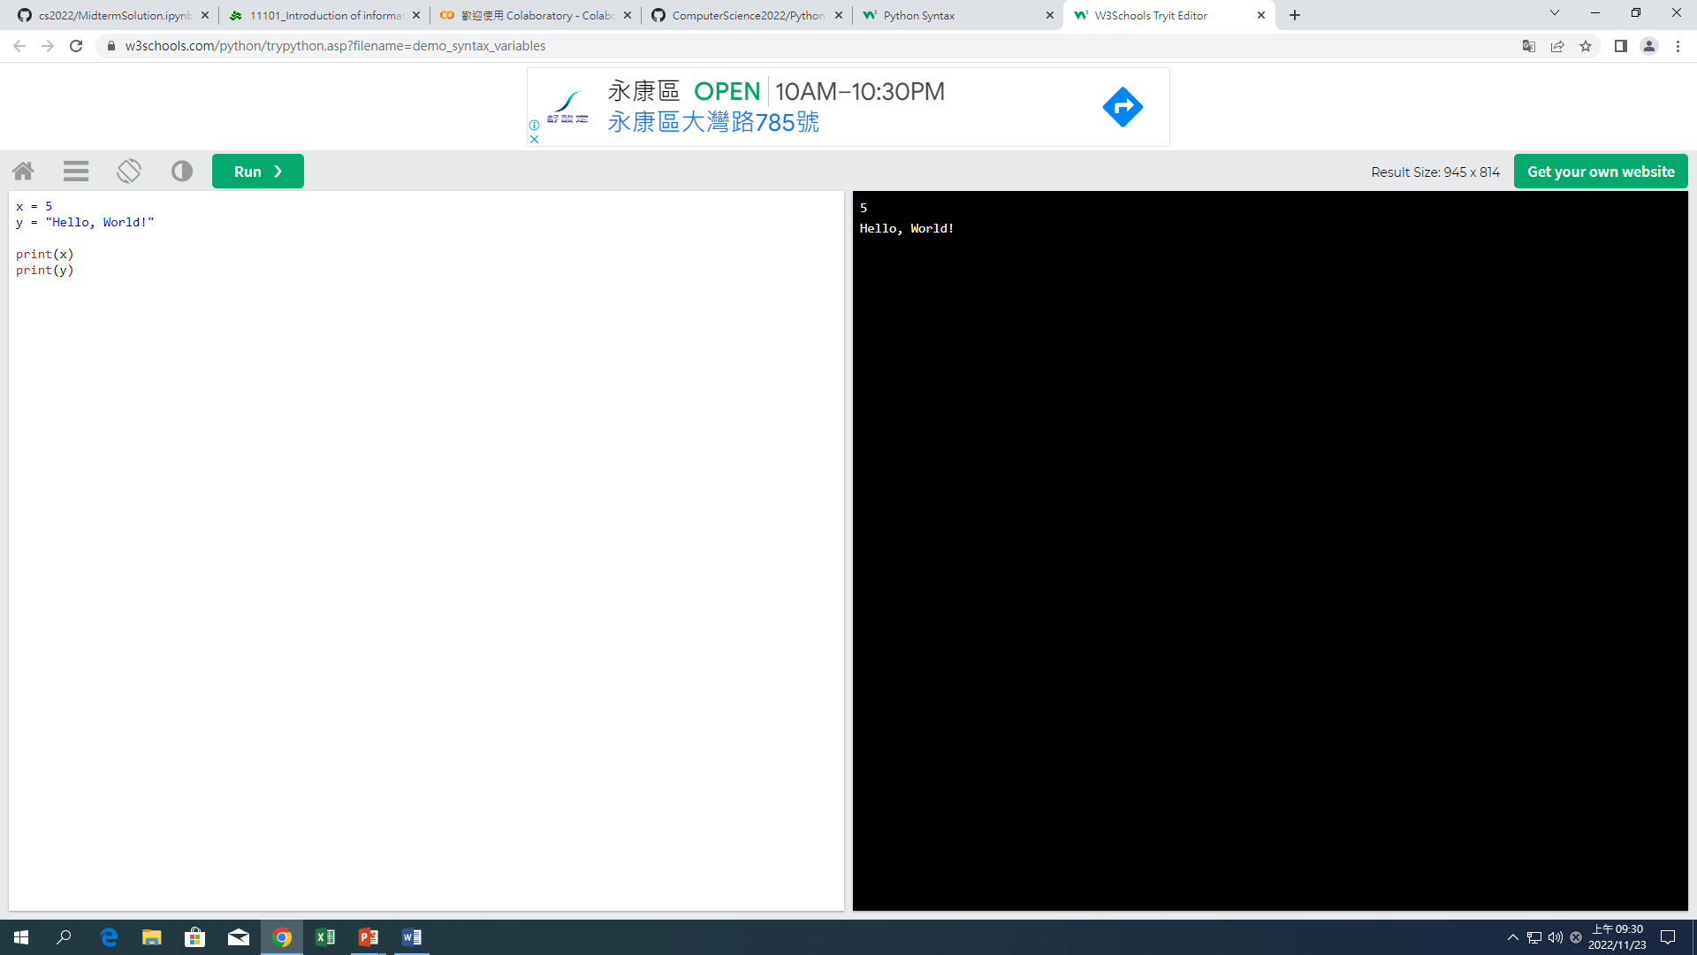
PYTHON VARIABLES
In Python, variables are created when you assign a value to it:
Comments
Python has commenting capability for the purpose of in-code documentation.
Comments start with a #, and Python will render the rest of the line as a comment:
EXAMPLE:
EXAMPLE:

